Slide 1
CS4048 Data Science
Lecture – 12 & 13

Slide 2
Categorical Variables Association Test - Chi Square Test
The Chi-Square (χ²) test is a statistical test used to determine if there is a significant association between two categorical variables
It a non parametric test not based on any assumption or distribution of any variable
This statistical test follows a specific distribution known as chi square distribution
This test is based on frequencies and not on the parameters like mean and standard deviation
This test measures the differences between what is observed and what is expected according to an assumed hypothesis
This test does not give us much information about the strength of relationship between variables

Slide 3
Chi Square Test
This test can be used in:
Goodness of fit of distribution
test of independence of attributes
test of homogeneity
The Chi-Square Test for Homogeneity checks whether the distribution of a categorical variable is the same across different populations or groups. By comparing the observed and expected frequencies across these groups, the test determines if the groups are homogeneous in terms of the variable in question

Slide 4
Chi Square Distribution
The chi-square distribution is asymmetrical and only takes on positive values (since the squared differences are always positive)
The shape of the distribution depends on the degrees of freedom (df), which are based on the number of categories in the test
A higher number of degrees of freedom shifts the distribution

Slide 5
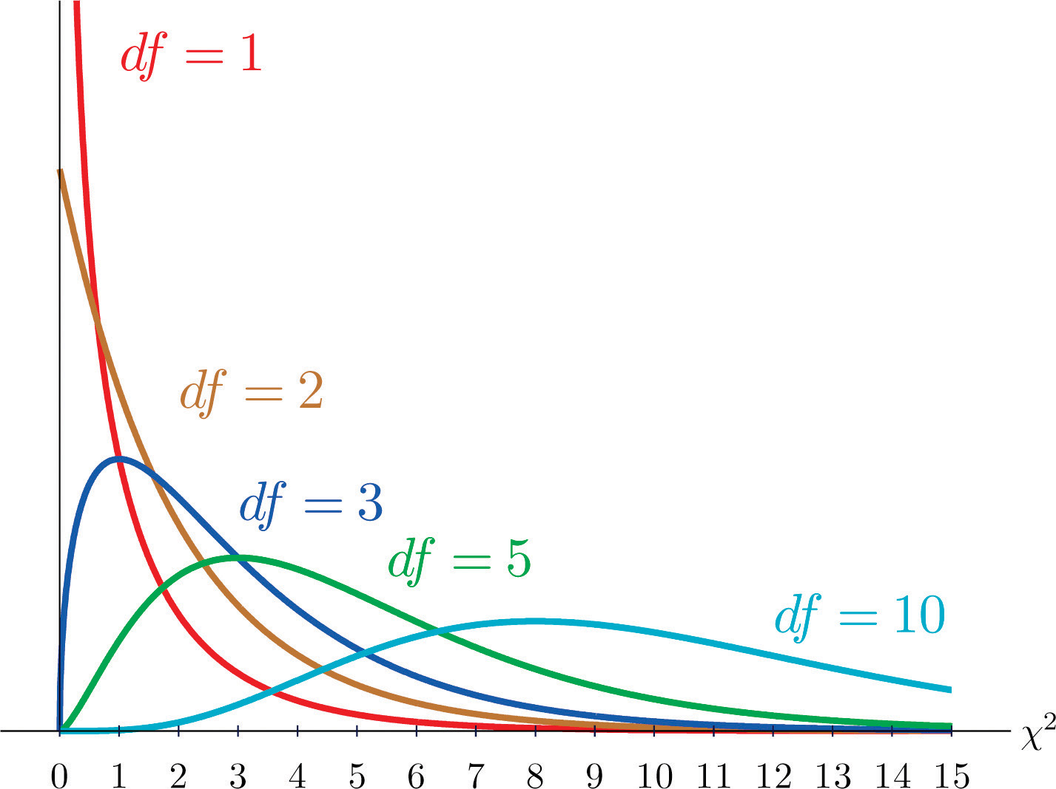
Chi Square Distribution
If X1,X2,X3,...,Xn are independent normal variables and each is distributed normally with mean zero and standard deviation unity, then ⅀Xi² is distributed as chi square with n degrees of freedom

Slide 6
Chi Square Distribution
if degree of freedom is >2
Distribution is bell shaped
if degree of freedom is =2
Distribution is L shaped with maximum ordinate at zero
if degree of freedom is <2
Distribution is L shaped with infinite ordinate at the origin

Slide 7


Chi Square Test - Formula
where,
degree of freedom (df)
Independence: df=(r-1)(c-1), where no. rows and c no of columns in contingency table
Goodness-to-Fit:
df=n-1, where n is the number of categories

Slide 8
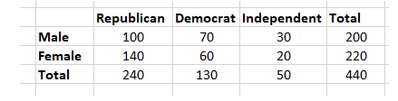
Example#1:
Let's say you want to know if gender has anything to do with political party preference. You poll 440 voters in a simple random sample to find out which political party they prefer. The results of the survey are shown in the table below:

Slide 9
Step 1: Define the Hypothesis
H0: There is no link between gender and political party preference.
H1: There is a link between gender and political party preference.

Slide 10


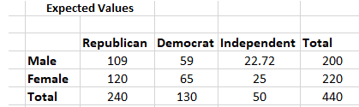
Step 2: Calculate the Expected Values
For example, the expected value for Male Republicans is:

Slide 11
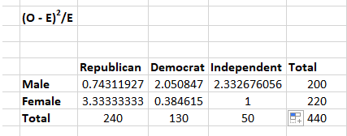
Step 3: Calculate (O-E)² / E for Each Cell in the Table

Slide 12
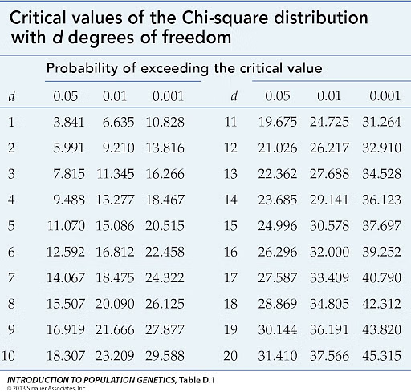
Step 4: Calculate the Test Statistic X²
= 0.743 + 2.05 + 2.33 + 3.33 + 0.384 + 1 =9.837
Degrees of freedom are calculated as:
If the chi-square statistic is greater than the critical value, or if the p-value is less than the significance level (usually 𝛼=0.05), you reject the null hypothesis.
The chi-square statistic of (9.837) is higher than the critical value (5.991) for a 0.05 significance level, indicating a significant link between gender and political party preference. Therefore, we reject the idea that there is no relationship between gender and political affiliation.

Slide 13
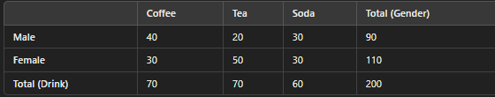
Example#2:
Suppose a researcher wants to test if there is a relationship between gender (male, female) and preference for a type of drink (tea, coffee). The observed frequencies are given in a contingency table:

Slide 14
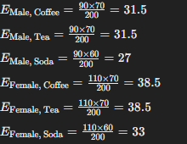
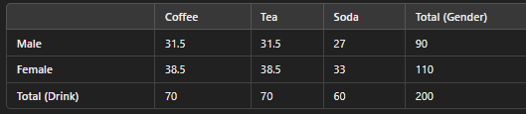
Null Hypothesis (H₀): Gender and drink preference are independent.
Alternative Hypothesis (H₁): Gender and drink preference are dependent.
For each cell, the expected frequency is:

Slide 15
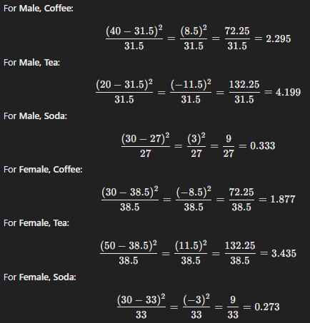
χ²=2.295+4.199+0.333+1.877+3.435+0.273=12.412
df=(2−1)×(3−1)=1×2=2
What is your conclusion??

Slide 16
Limitations
There are two limitations to using the chi-square test:
The chi-square test, for starters, is extremely sensitive to sample size. Even insignificant relationships can appear statistically significant when a large enough sample is used. Keep in mind that "statistically significant" does not always imply "meaningful" when using the chi-square test
Be mindful that the chi-square can only determine whether two variables are related. It does not necessarily follow that one variable has a causal relationship with the other

Slide 17
EDA: Visualization
In data exploration, generally we focus on:
Summary statistics
Descriptive Statistics : Measures of Location and Spread
Visualization: Different types of charts serve distinct purposes, allowing us to understand the data in various ways:
Histogram
BOX plot
Scatter Plot
Heat map
Line chart
Bar chart
Pie chart
Multiline chart
Donut chart
Spider chart
Pair plot
Bubble chart

Slide 18
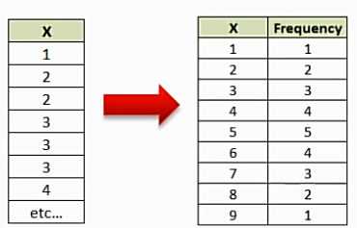
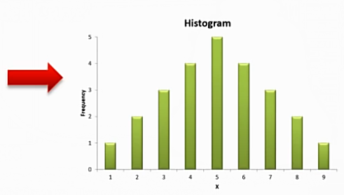
Histogram
Histogram is a bar chart that groups numbers into ranges or bins
Histograms displays data using bars of different heights allowing us to evaluate the shape of the underlying distribution

Slide 19
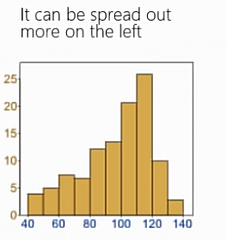
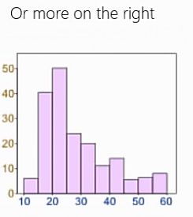
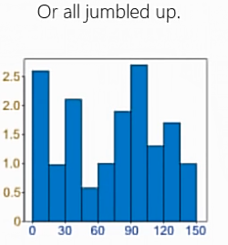
Histograms
Data can be distributed (spread out) in many different ways. It can be spread out more on the left Or more on the right Or all jumbled up.

Slide 20
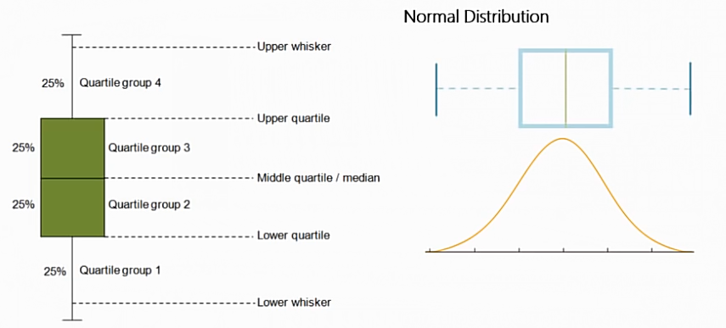
Box Plot
A Boxplot is a nice way to graphically represent the data in order to communicate the data through their quartiles.

Slide 21
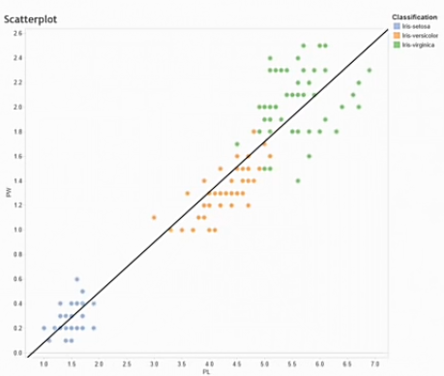
Scatter Plots
A point plot between two variables used to understand the spread of the data.
The spread of the data allows
for us to understand if the data has
a non-linear or linear relationship
and the relative degree of the
correlation in the data.
This technique can allow be used to
detect outliers in the data.
A scatterplot becomes more powerful
when you incorporate categorical
data as an additional dimension.

Slide 22
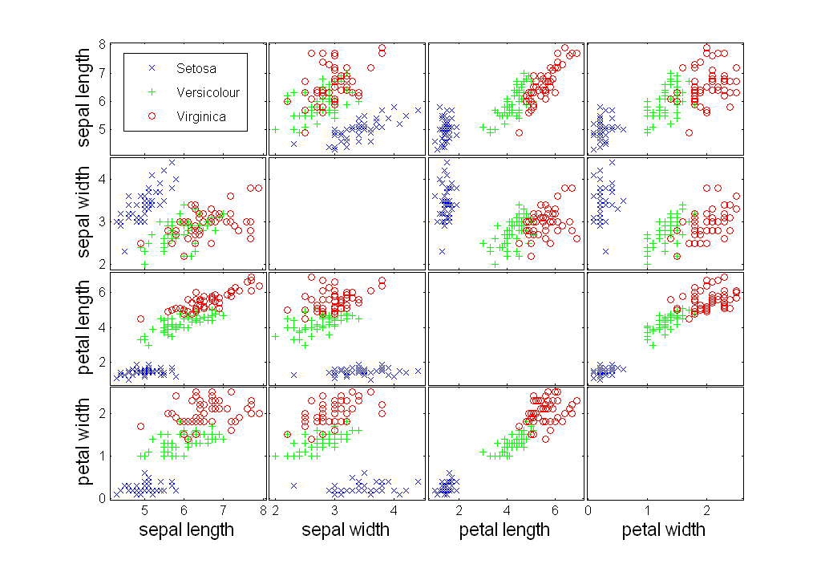
Scatter Plot

Slide 23
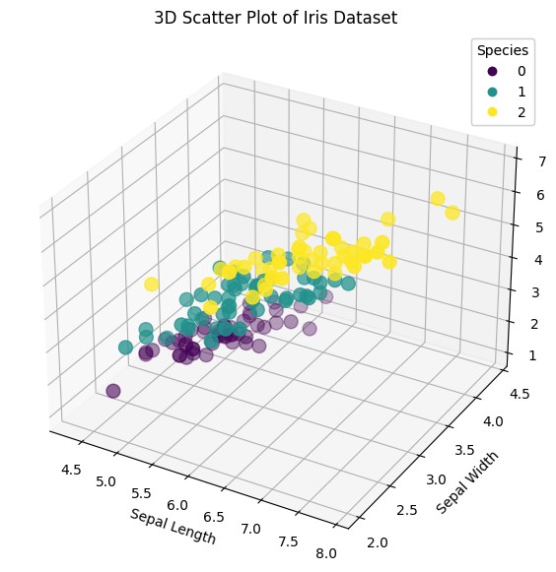
3D Scatter Plot
A 3D scatter plot is a visualization tool that displays three dimensions of data, allowing for the representation of three variables simultaneously
When you have three continuous variables that you want to analyze simultaneously
Used to detect clusters, patterns, or outliers in three-dimensional space.

Slide 24
Heat Maps
A heat map is the visualization of data that represents the magnitude of a value in a color code ranging from minor to major intensity
Heat maps are valuable tools for exploring and understanding complex data sets. They help in identifying patterns, outliers, correlations, and trends that might not be apparent when examining raw data.
There are two main types of heatmaps:
The Spatial Heat Map: Represented with a canvas that represents a two-dimensional space; it can be a geographical map, a web page, or other cartesian representation.
Grid/Matrix Heat Map: This type of heat map displays the magnitude of a phenomenon using a two-dimensional matrix. Columns and Rows categorize a cell (the location) and the cell’s color code defines the phenomenon’s value intensity.

Slide 25
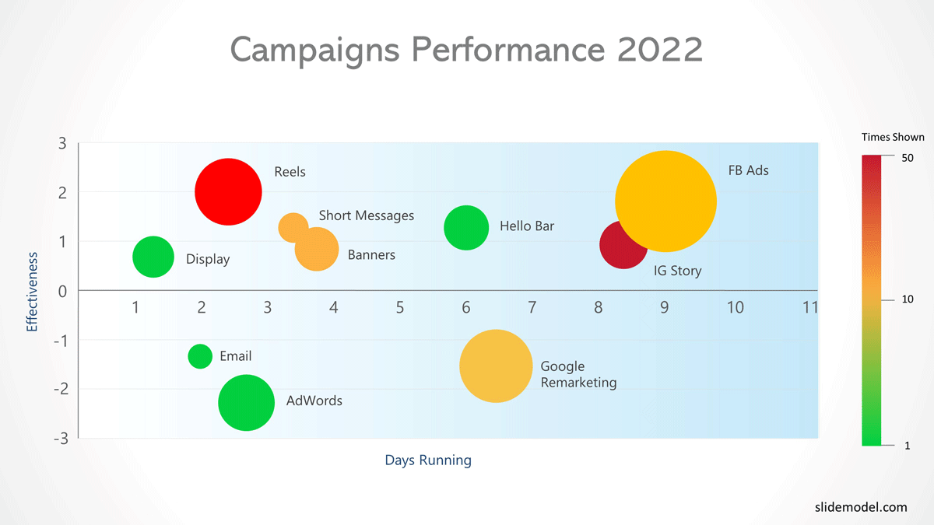
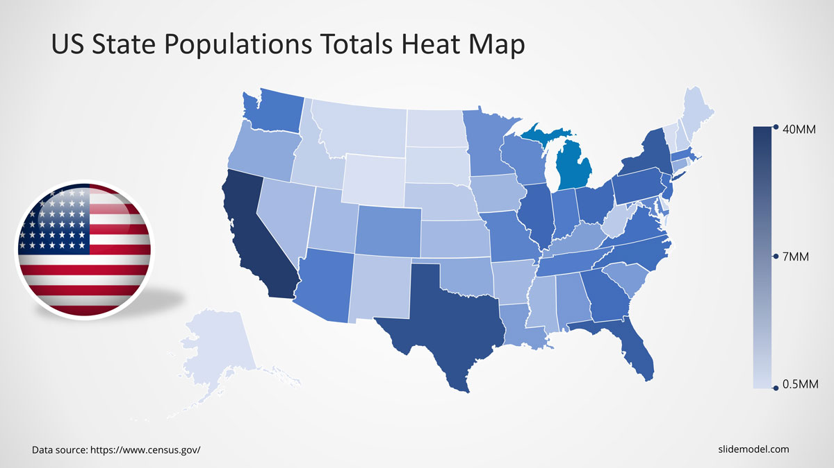
Spatial Heat Map

Slide 26
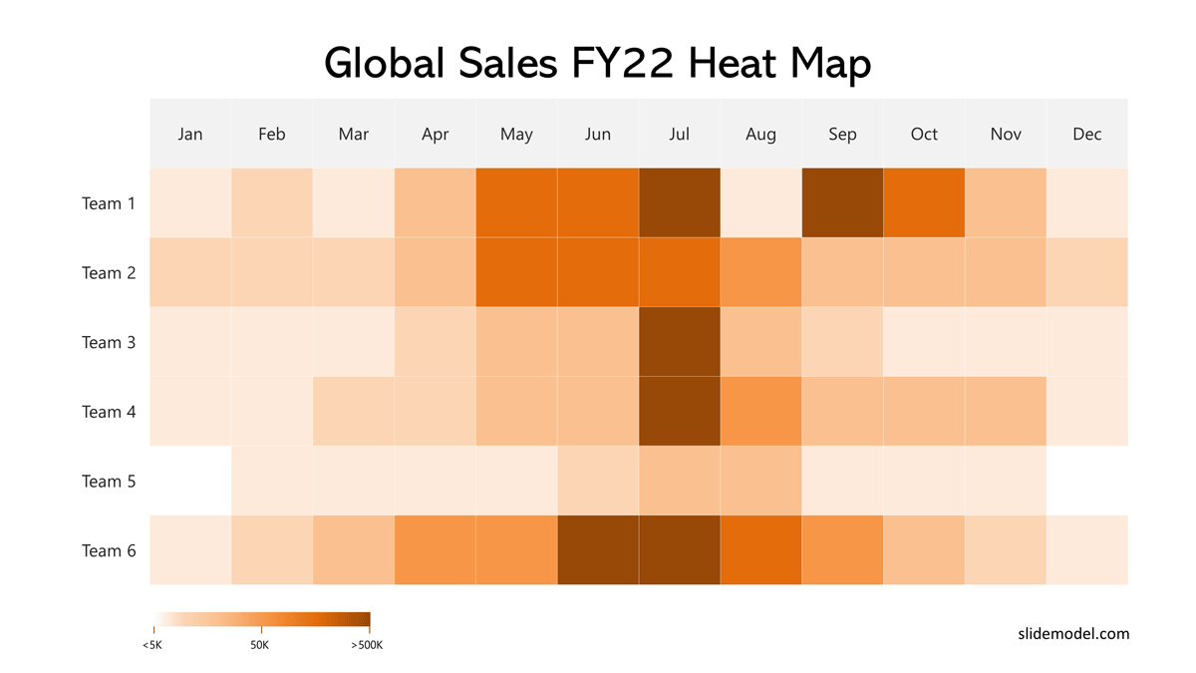
Matrix Heat Map

Slide 27
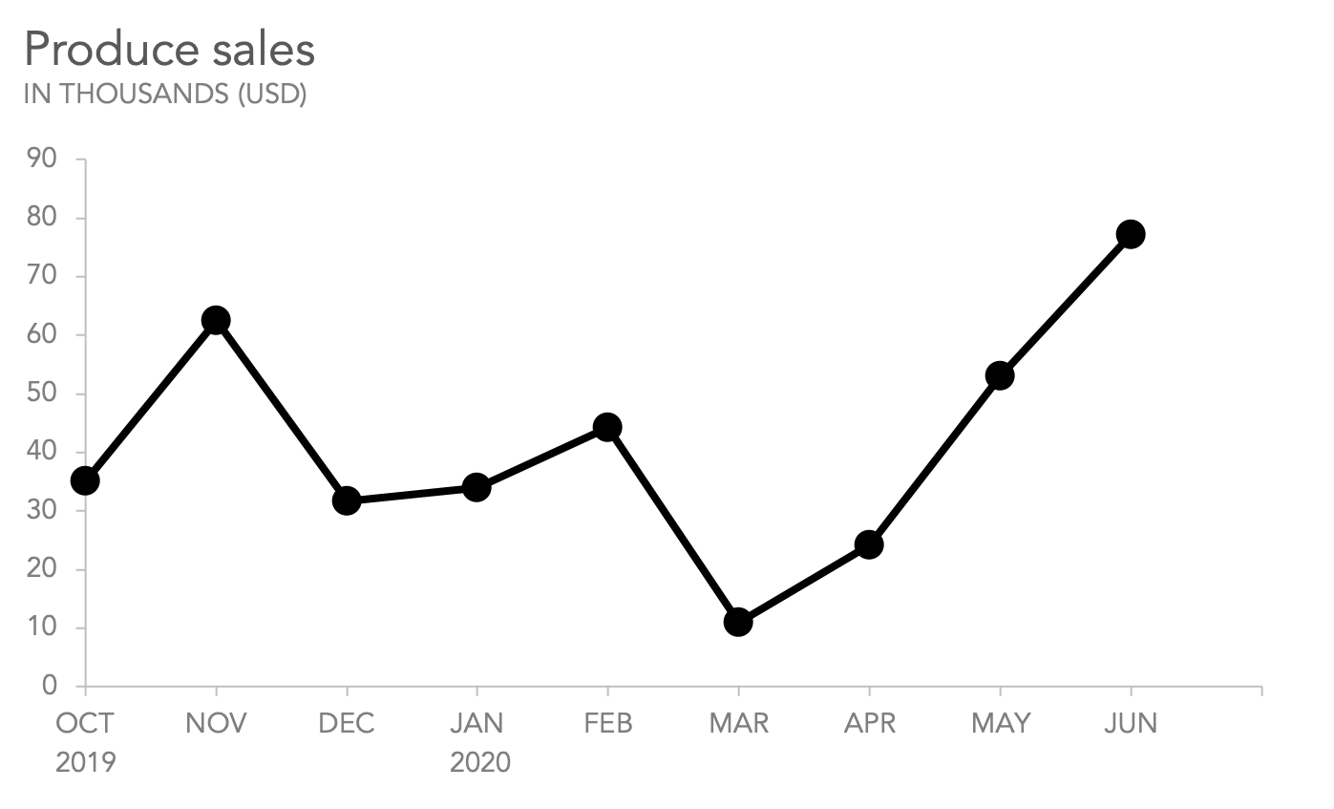
Line Chart
A line chart shows data points over a continuous time interval. Best for visualizing trends over time
Use when plotting time series or sequential data
Points are connected by line segments to emphasize progression across time

Slide 28
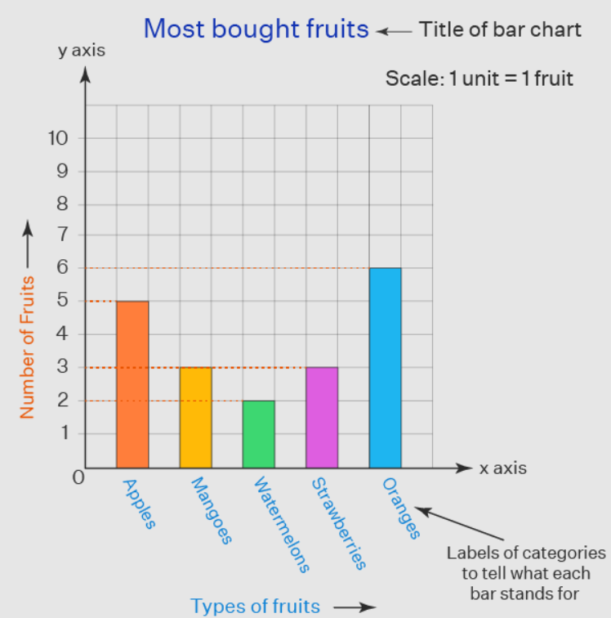
Bar Chart
A bar chart is used to compare categories using rectangular bars.
Use for categorical data or comparing quantities among different groups.

Slide 29
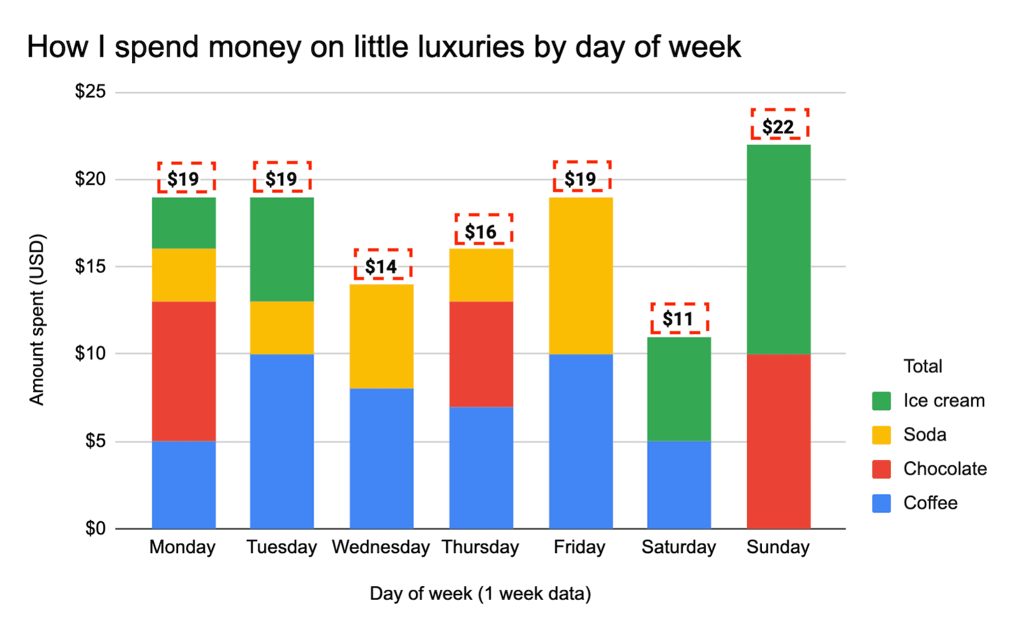
Stacked Bar Chart
A bar chart where each bar has been divided into multiple sub bars to a part to whole breakdown
A single stacked bar can be used as an alternative to the pie or donut chart
Categorical data with subcategories that you want to compare in terms of composition and totals.

Slide 30
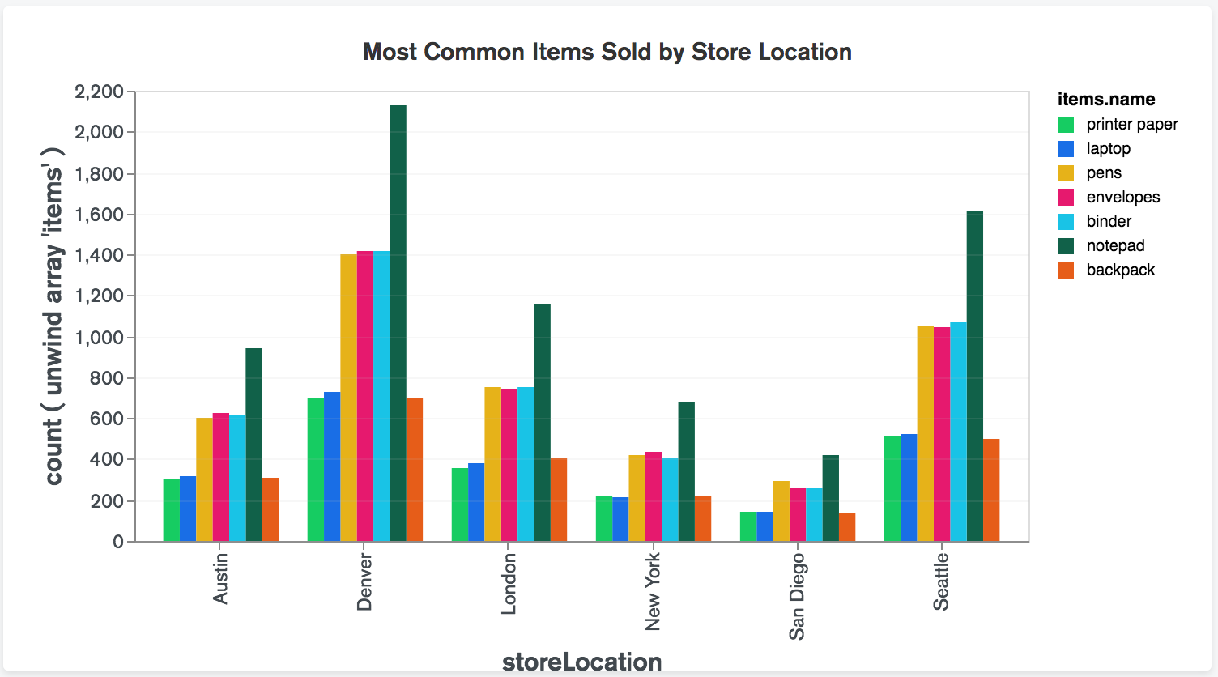
Grouped Bar Chart
A grouped bar chart places the subcategories side by side within each category for clearer comparison
It’s effective when you want to focus on the differences or trends in subcategories across various categories.
Clear visibility of subcategory values: When you want the individual values of each subcategory to be clearly visible and not stacked on top of each other.

Slide 31
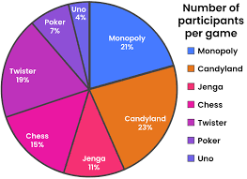
Pie Chart
A pie chart shows proportions of a whole and is best for visualizing parts of a whole Used to compare the contribution of categories to a total

Slide 32
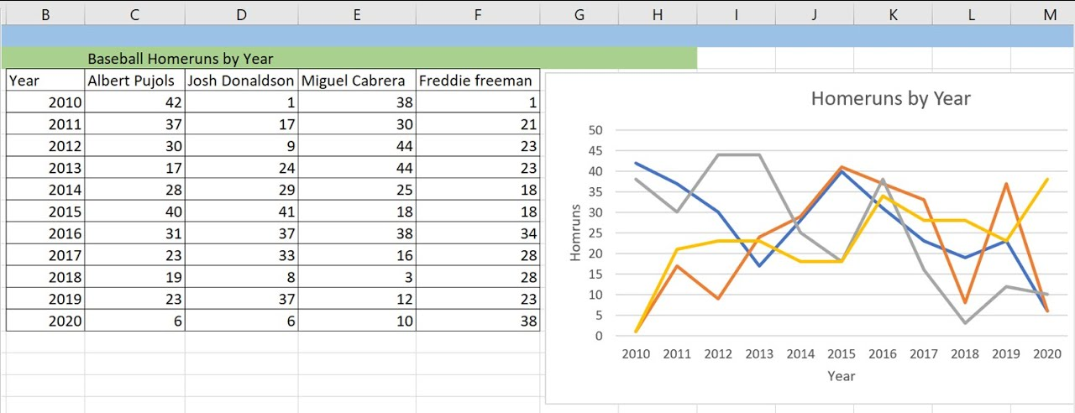
Multiline Chart
Similar to a line chart but with multiple lines and is useful for comparing trends between multiple variables over time
Used when comparing multiple data series

Slide 33
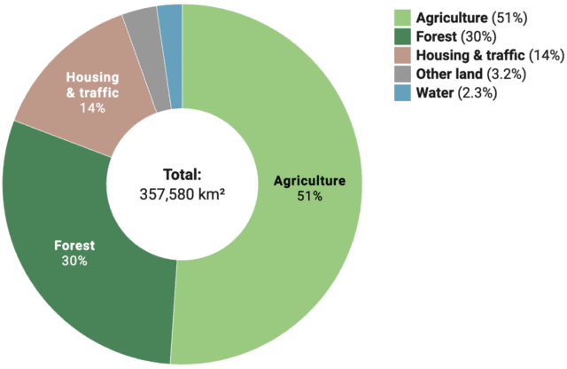
Donut Chart
A donut chart is a variation of a pie chart with a hole in the center.
It is also used to show proportions
Use when you want to add additional information in the center of the chart

Slide 34
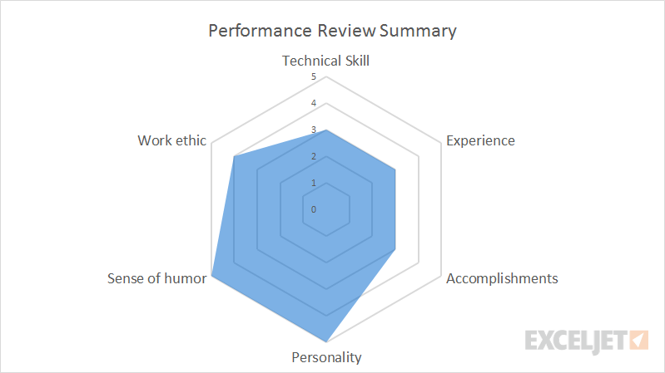
Spider/Radar Chart
A spider chart is used to display multivariate data on a two-dimensional plane
Each axis represents one variable
Useful for comparing multiple variables for different entities/metrics

Slide 35
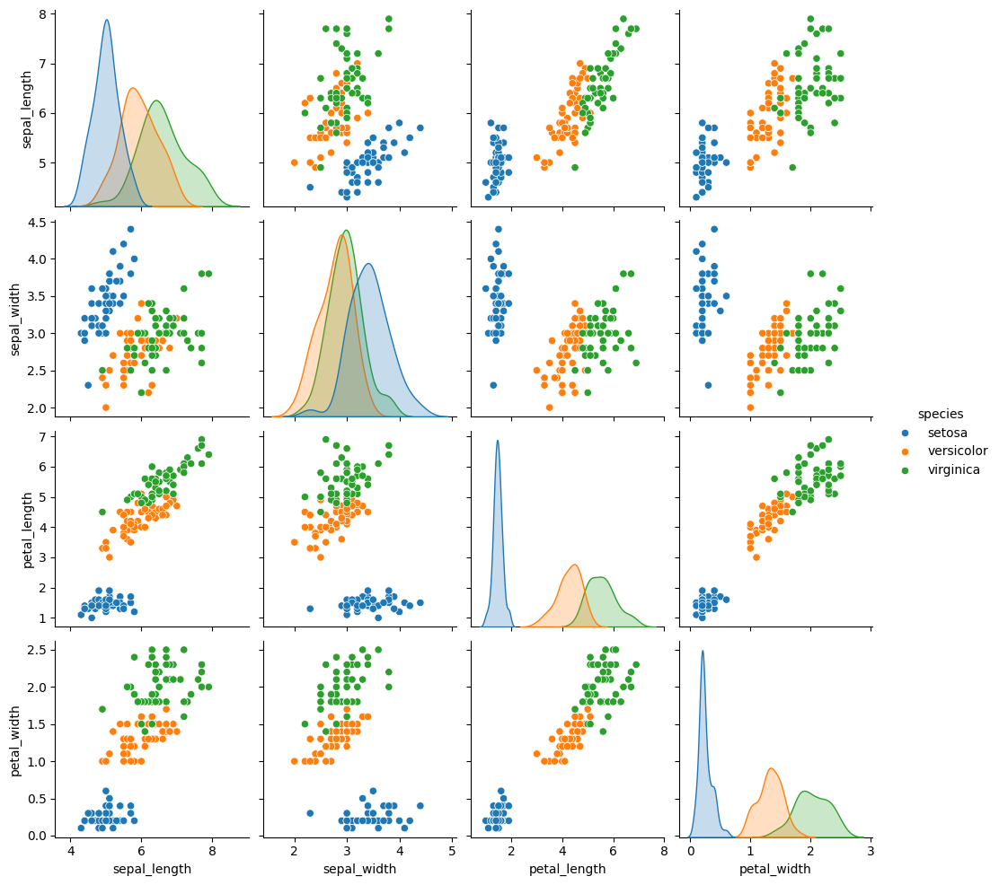
Pair Plot
Pair plots are used to visualize relationships between multiple variables in a dataset
A pair plot provides a grid of scatterplots that show the relationships between each pair of features

Slide 36
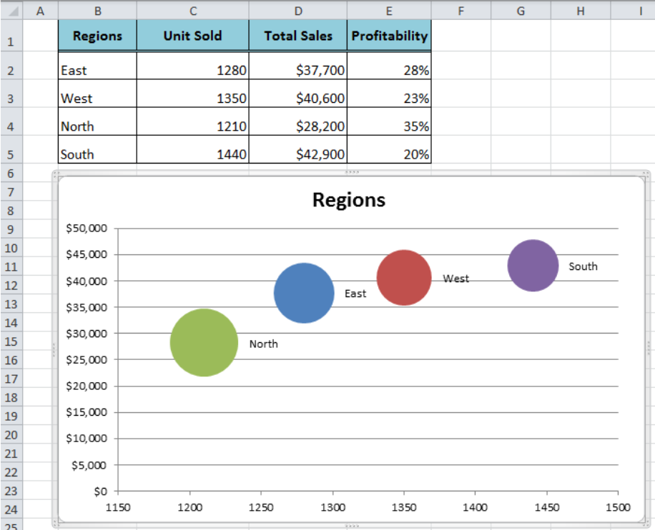
Bubble Chart
A bubble chart is similar to a scatter plot but with an additional dimension represented by the size of the bubbles
Use when you want to show relationships between three variables
Best suited for continuous numerical data; less effective for categorical or ordinal data, which can lead to misleading interpretations

Slide 37
Sample Example On Google Colab
The Jupyter notebook will be shared on GoogleClassroom

